Slide 1
10 Second Timer
Stark

Slide 2
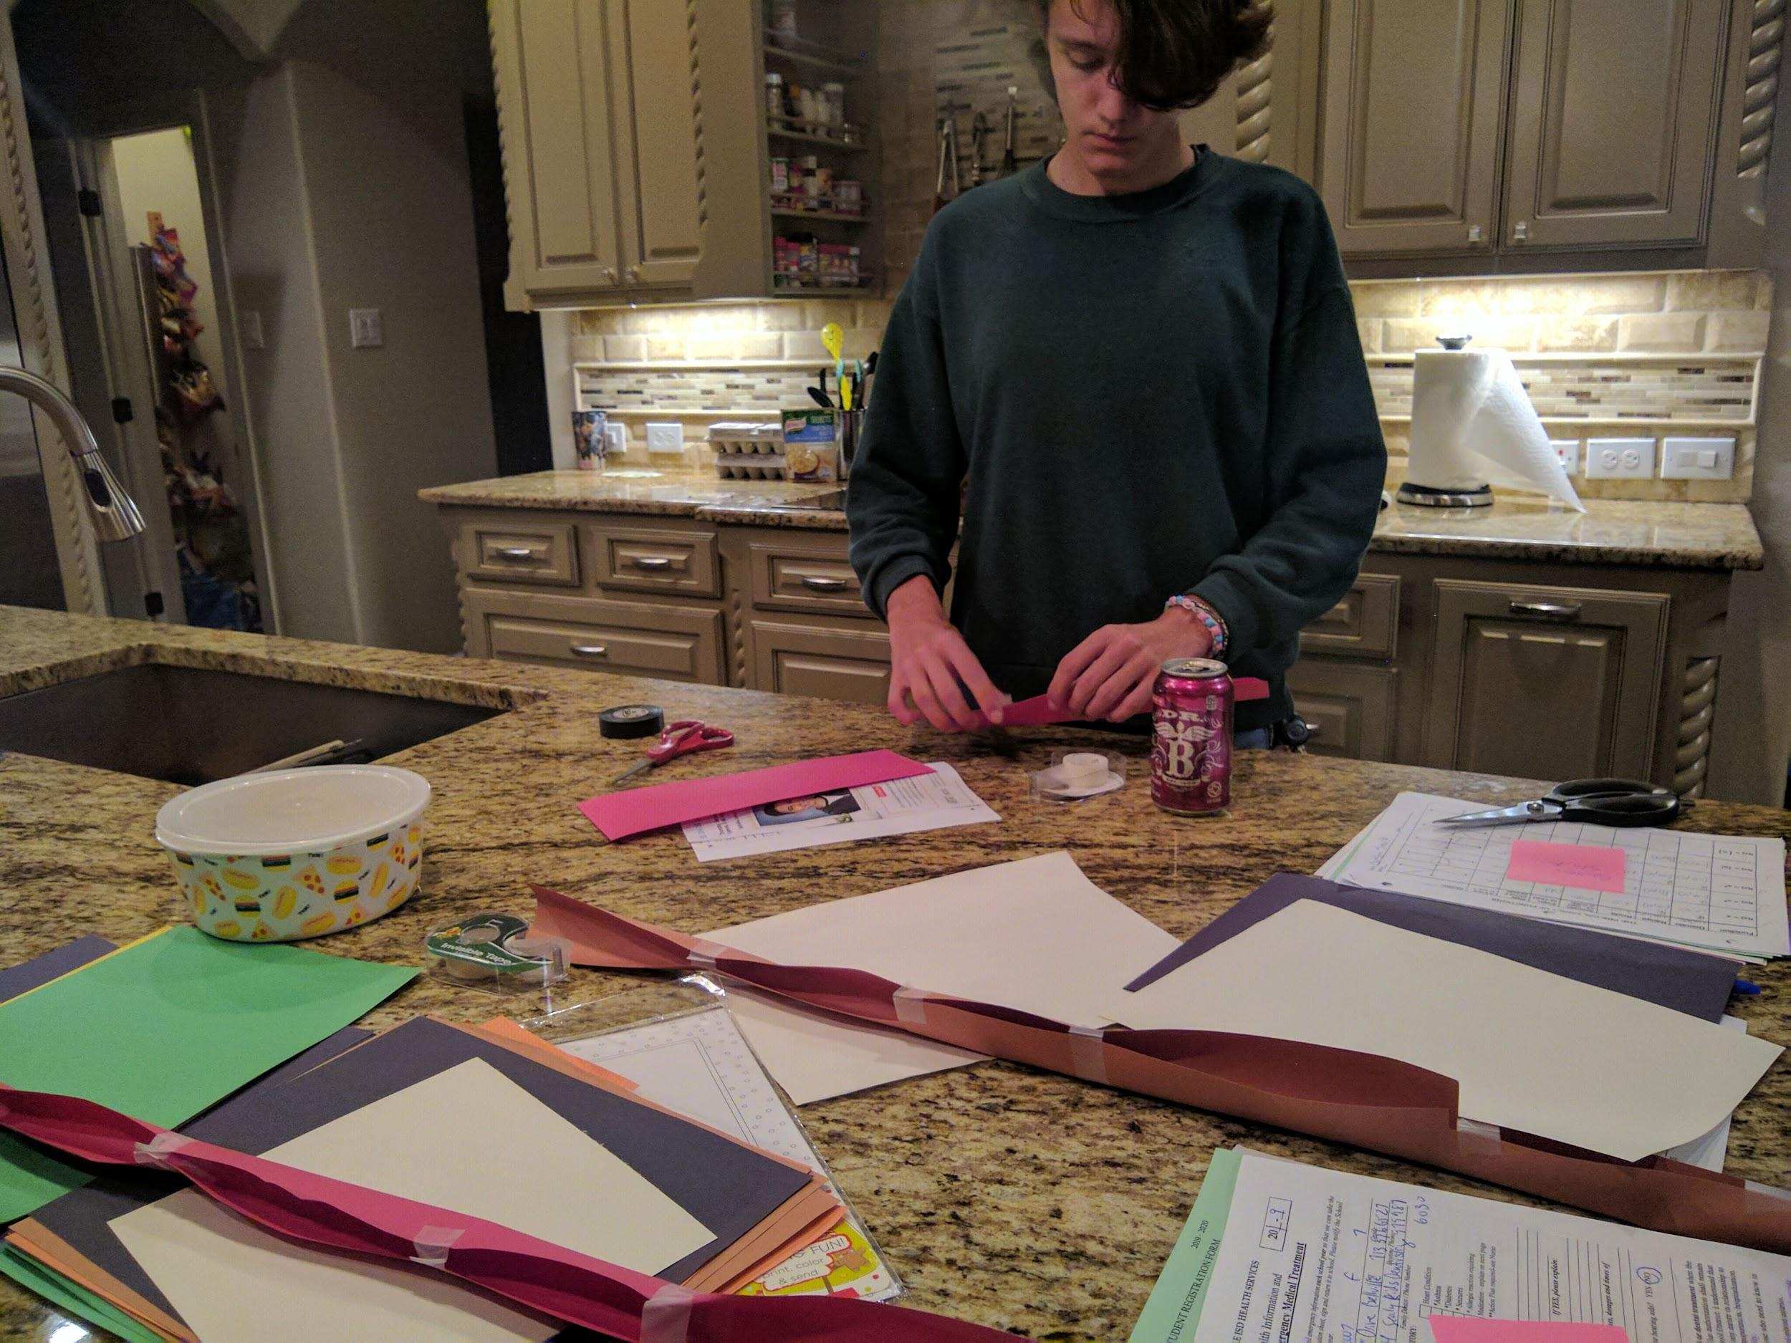
design
Me planning out how my marble track is going to go and setting up the base components, that being rails made out of construction paper I'm going to make tubes and put them on a foldable table.

Slide 3
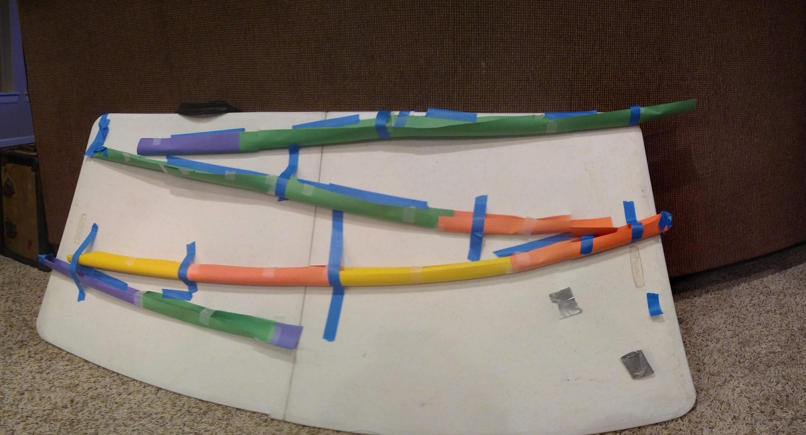
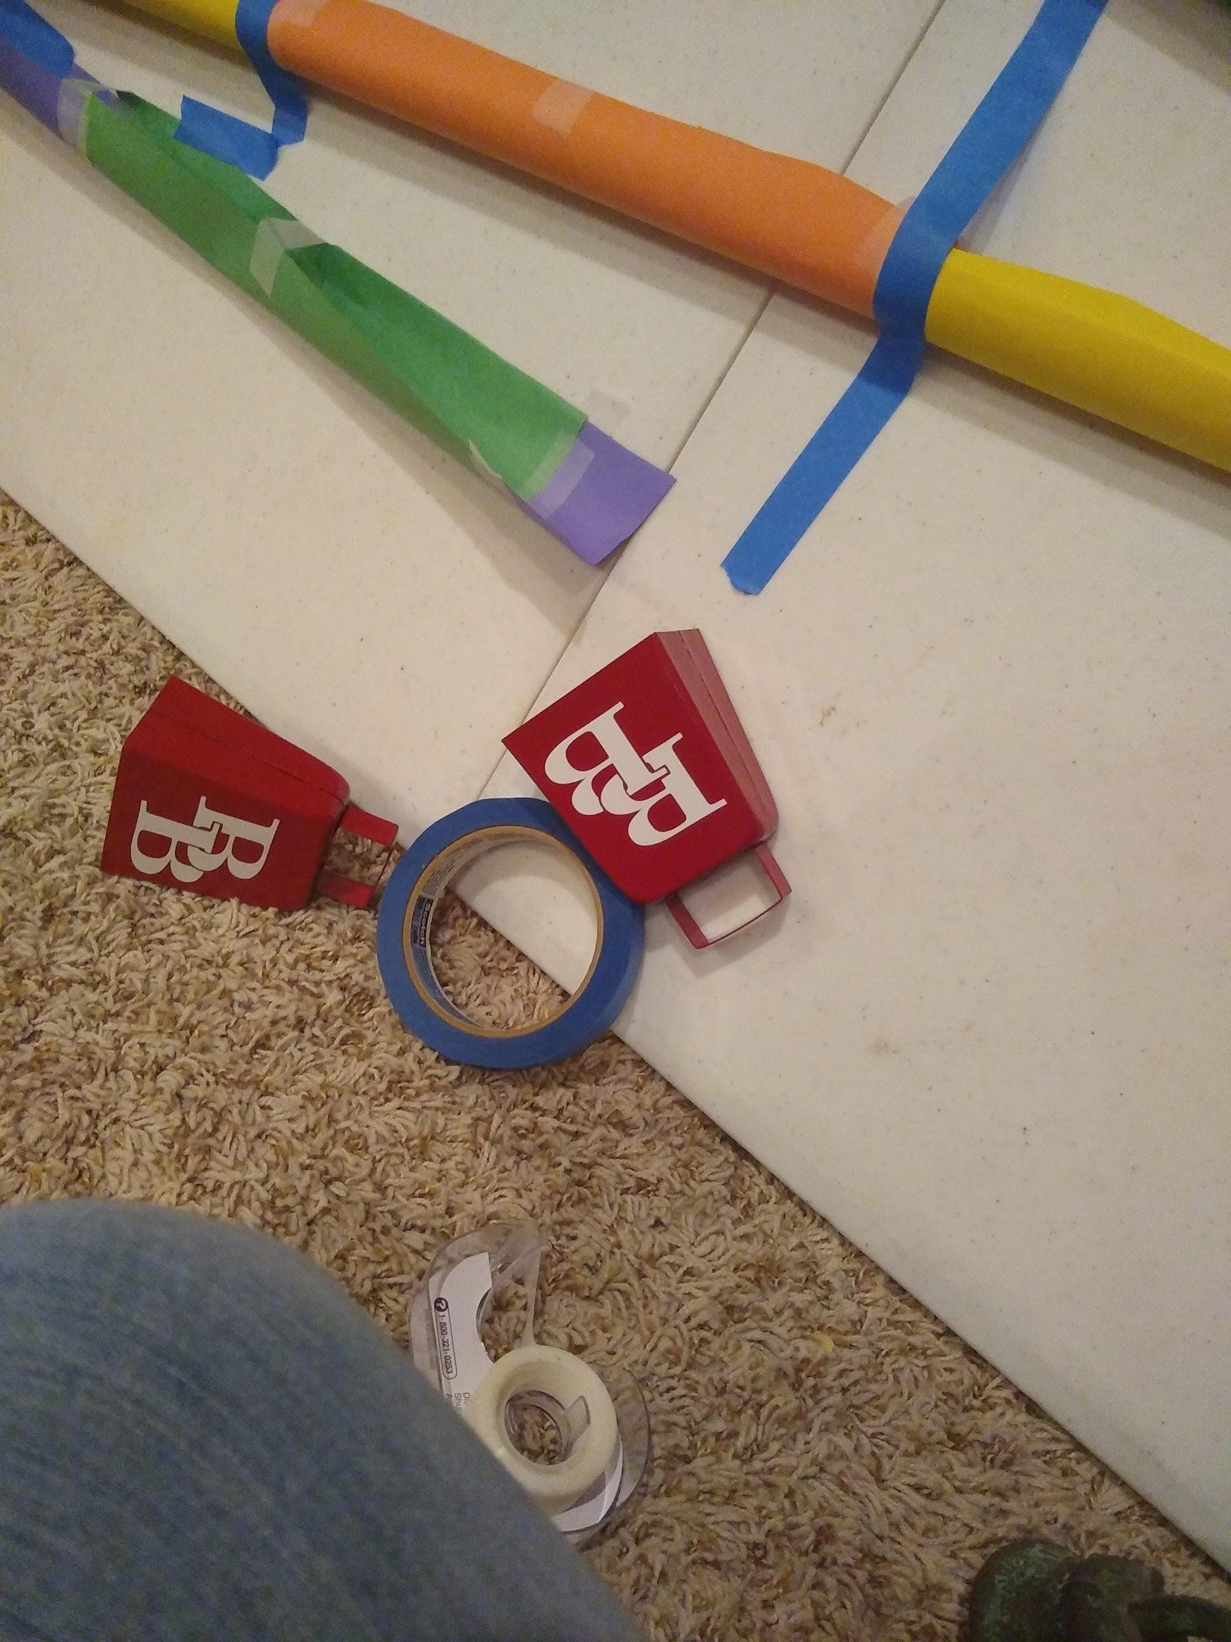
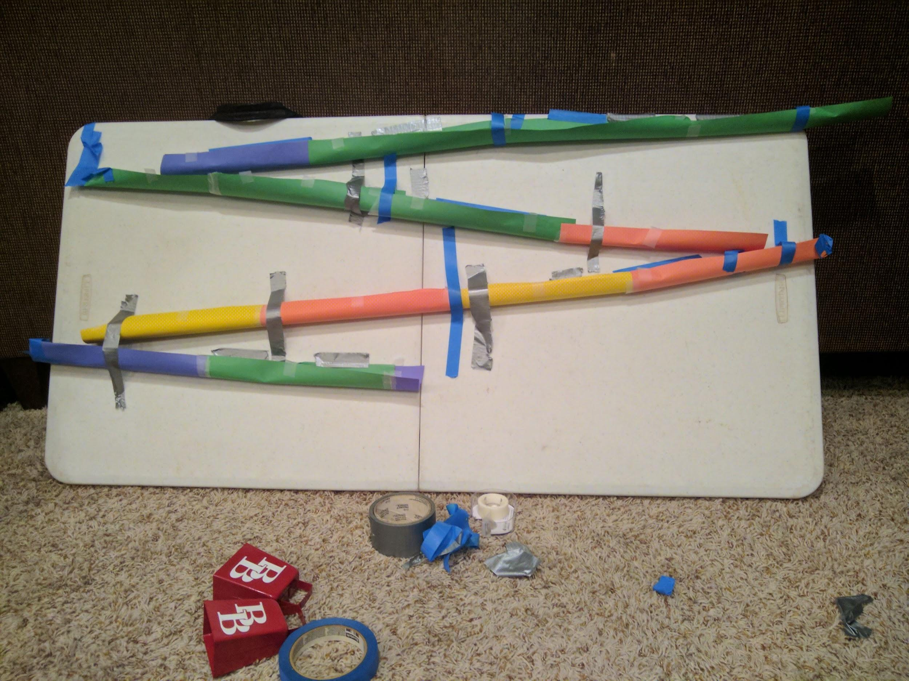
building
A couple in progress images of my marble track. First, I used masking tape to adhere my construction paper tubes to the table, then I tested how long it was going to take and cut to size. After finding the right length, I redid it permanently with duct tape. Finally, I set up the marble to knock over a bell onto another bell.

Slide 4
operation
My marble track leads a marble down a set of construction paper tubes for nine seconds, then it lands in a bell and rolls onto another bell, completing in 10 seconds.

